Slide 1
SIMULATION FOR LARGE ULTRASONIC ARRAYS
By: Seth Freeman, Richard Sack, Hayden Thurman, Abdul Wasit Yahaya, Joshua Mcclure, Ethan Higginbotham
Group work

Slide 2
Objective
To generate a 3D field of sound waves and the pressure at each point.
Use a GUI to generate a 3D-plot using Spatial data
Use a for large data analysis

Slide 3
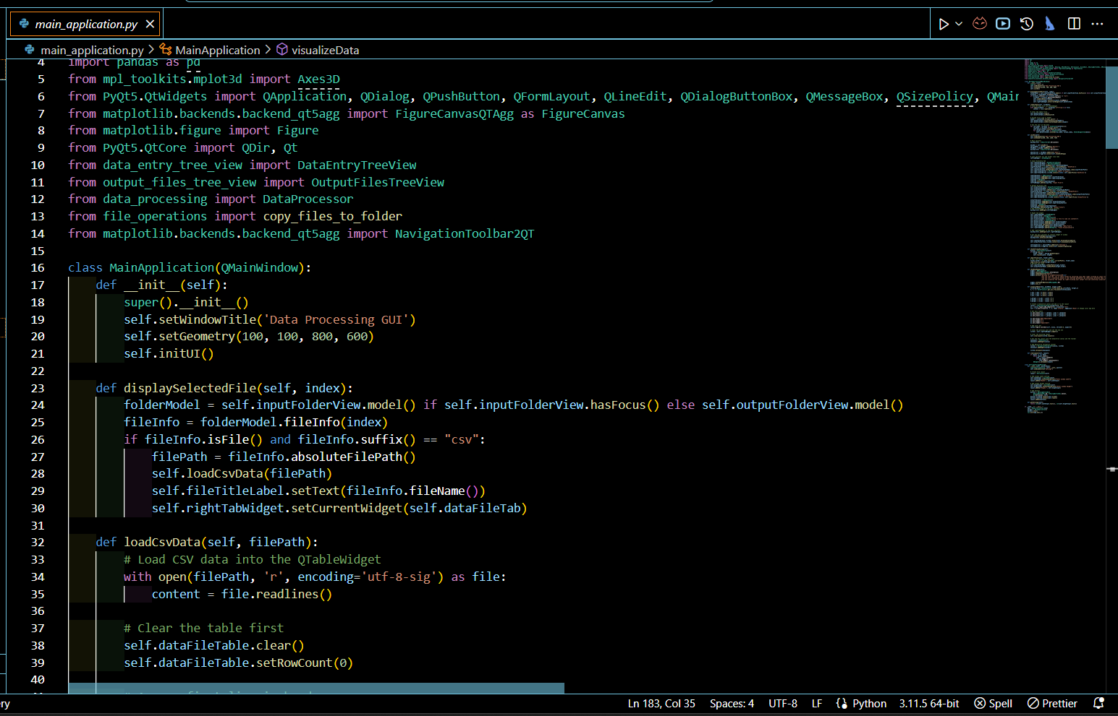
Codes
The entire simulation was based on 8 different python scripts:
Calculation_dialog.py
data_entry.py
data_entry_tree_view.py
data_processsing.py
File_operations.py
main_application.py
file_utils.py
output_files_tree_view.py

Slide 4
Contd...
Calculation_dialog.py Class 'CalculationDialog' (inherits 'QDialog'): This class is a GUI component for handling calculations. It includes:
An 'init' method to initialize the dialog with a file path.
'initUI' method for setting up user interface elements.
'runProcessing' for performing data processing tasks, which includes steps like CSV file reading, grid generation, 3D array processing, and calculations of magnitude and phase. d. 'appendStatus' method for updating the dialog with messages to display calculation progress

Slide 5
Contd...
data_entry.py' a. Class 'DataEntry': This class contains the properties ID, phase, position, and orientation of the transducers
Data_entry_tree_view.py' Class 'DataEntryTreeView' (inherits 'QTreeView'): A specialized tree view for displaying data entries. It includes :
'contextMenuEvent' for handling right-click menu actions.
Methods like 'viewFile', 'calculateFile', and 'deleteFile', interactive features for file manipulation within the UI

Slide 6
Contd...
Data_processsing.py' Functions for data processing: Includes several standalone functions and a class for data processing:
'generate_grid', 'process_grid_chunk', and 'process_3d_array' for handling 3D spatial data.
'calculate_magnitude_phase' for post-processing results.
Class 'DataProcessor': Methods like 'filter_data_by_z' and 'get_xyz_from_data' indicate functionalities for filtering and extracting spatial data.

Slide 7
File_operations.py' File related operations:
'read_csv' for reading CSV files with unit conversion (meters to millimeters).
'export_results_to_csv' for exporting processed data.
'copy_files_to_folder' for file management

Slide 8
Contd...
Main_application.py' Class 'MainApplication' (inherits 'QMainWindow'): The central class for the application's UI.
Methods for UI initialization ('initUI'), settings dialog ('showSettingsDialog'), file import ('importFiles'), help dialog ('showHelpPopup'), and data visualization ('visualizeData').
'clearLayout' for UI management, including dynamic UI updates.
Class 'SettingsDialog' (inherits 'QDialog'): For handling application settings, with methods for retrieving settings

Slide 9
Contd...
'file_utils.py' Class 'FileUtils': Contains utility methods like 'deleteFile', providing basic file manipulation functionalities.
output_files_tree_view.py' Class 'OutputFilesTreeView' (inherits 'QTreeView'): Similar to 'DataEntryTreeView', it's tailored for output file management with context menu actions and file manipulation methods in the output files tab.

Slide 10
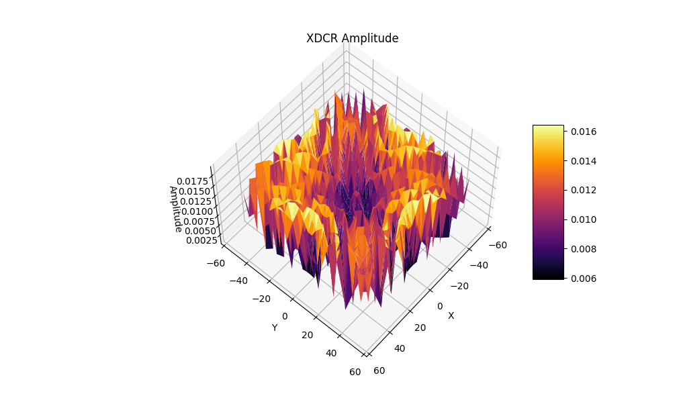
Implementation
Uses soundwaves and calculates the pressure amplitude by calculating the contribution of each soundwave at each point.
As well as complex exponential to give phase but isn’t visualized
Uses Python
  Matplotlib, Pandas, NumPy, PyQt5
  Uses CSV data files.

Slide 11
That’s it
Thanks for Watching!
https://github.com/Kyouryoku8/LargeUltrasonicSim

